Slide 1
Stoicism
Dr. Stephanie Spoto sspoto@mpc.edu
Monterey Peninsula College
Gentrain
15 November 2018

Slide 2
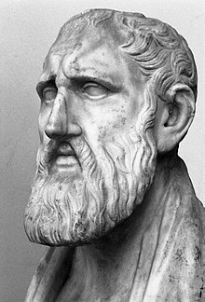
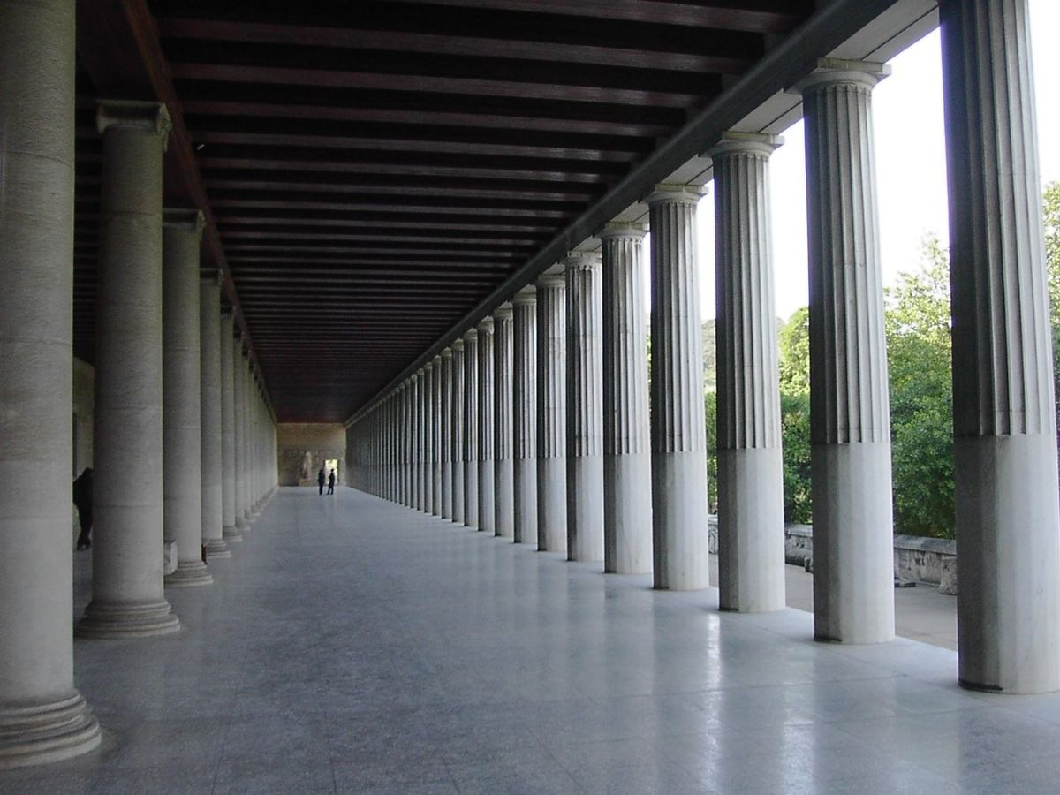
From Zeno to Epictetus
Zeno of Citium (336-264 BCE)
  Born in Citium, Cyrus
  Stoics named after stoa
Seneca (d. 65 CE)
  born in Cordoba in Hispania → raised in Rome
Epictetus (c. 55-135 CE)
  born a slave at Hierapolis, Phrygia (present day Pamukkale, Turkey)
Known primarily for contributions to ethics

Slide 3

What is a Stoic?

Slide 4
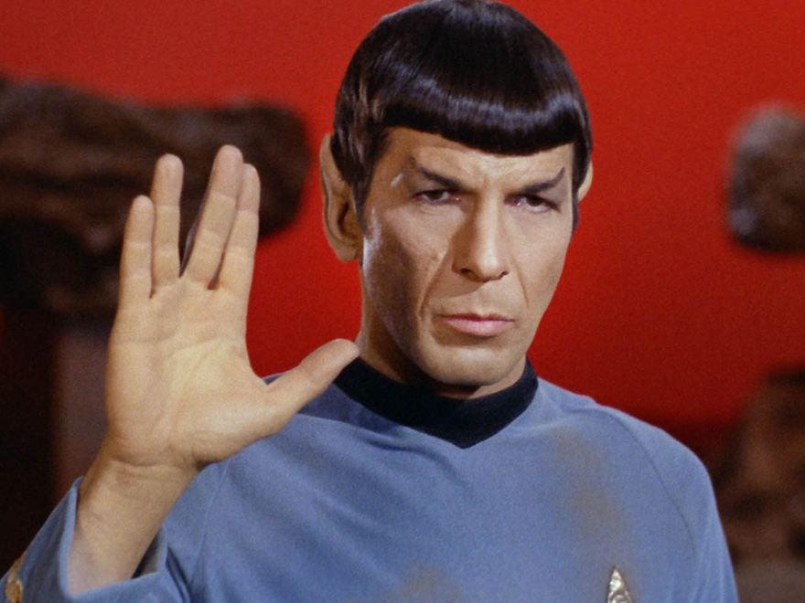


Stoicism in popular culture

Slide 5
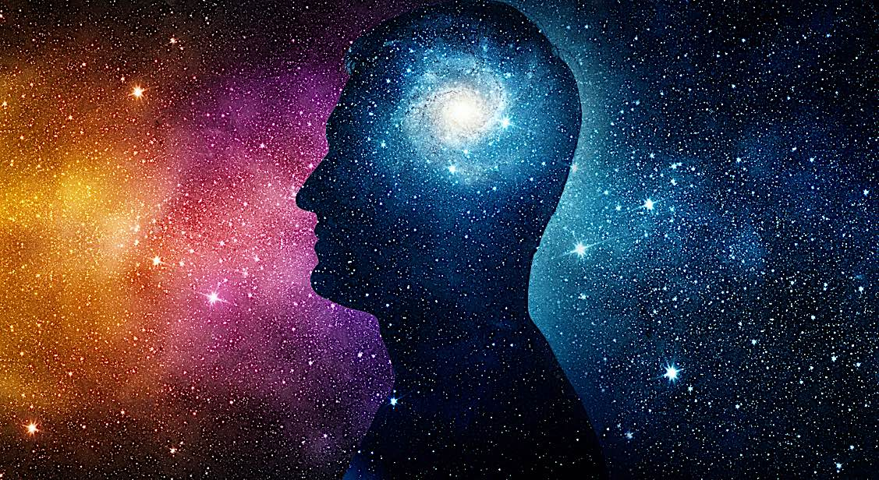
What did the Stoics believe?
Action in accordance to nature → highest good, leads to happiness
There exists ‘objective reality’ (nature) → orderly, regular, discernable by human reason
Human life (in accordance with nature) can be ordered by reason
Reason is an ordering power → order of nature intelligible → order of nature ordered by cosmic intelligence (Logos, Reason, Providence)

Slide 6
Morality not purely cultural
If knowledge of moral values, and these values constitute the order of culture → from order of nature (not convention)
True values are from nature & reason → constant, universal
Answer seemed near
  Reason orders human life & orders regularities of nature → also what understands/discerns the order
  Morality must be in accordance with nature → morality determined by reason
Reason, not convention, must discerns what is universal in human values and essential in human nature
Humans different than animals
  For humans to act in accordance with their nature is to act in accordance to their rationality.
Therefore MORAL LIFE = RATIONAL LIFE

Slide 7
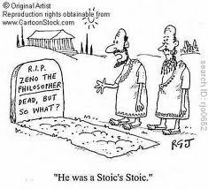
Virtue is sufficient for happiness
Natural = norm for truth and right; for human beings and nature, the natural is the rational
However, people’s values different than this → often do not conform to reason by only to convention, impulses, appetites
Stoics encouraged people to align their values to their nature → leads to happiness

Slide 8
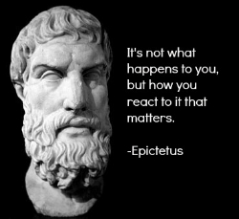
Stoicism and Apathy
All things (good and bad) are ordered by Logos → must accept fortunes without feeling
God orders misfortune to harden and strengthen the soul → develops character and inner strength
Apathy important in Stoic thought → the desired state of the soul, achieved as the true condition of happiness
  Apathy: a-pathos no feeling
  If fortunes are good → do not become to elated, respond rationally
  If fortunes bad → do not become resentful, but respond rationally

Slide 9
Emotional, not rational, indifference
Unlike ‘epicurean,’ ‘stoical’ is not misleading with regard to its philosophical origins.
Emotions like fear or envy (or impassioned sexual attachments, or passionate love of anything whatsoever) either were, or arose from, false judgements
The sage – a person who had attained moral and intellectual perfection – does not indulge or experience passion and emotion
Strong commitment to the rational against the emotional and irrational
Requires training, self-denial, self-discipline
  “the Stoic life” and “the Stoic virtues”

Slide 10
All vices equally vicious
Roman Stoics Seneca and Epictetus, emphasize the doctrines that the sage is immune to misfortune and that virtue is sufficient for happiness.
Phrase ‘stoic calm’ perhaps encapsulates the general drift of these claims.
More radical claim: only the sage is free while all others are slaves & that all those who are morally vicious are equally so.
Cicero, in De Finibus, has Cato putting the point:
“For just as a drowning man is no more able to breathe if he be not far from the surface of the water, so that he might at any moment emerge, than if he were actually at the bottom already … similarly a man that has made some progress towards the state of virtue is none the less in misery than he that has made no progress at all.” (De Finibus, IV.48)

Slide 11
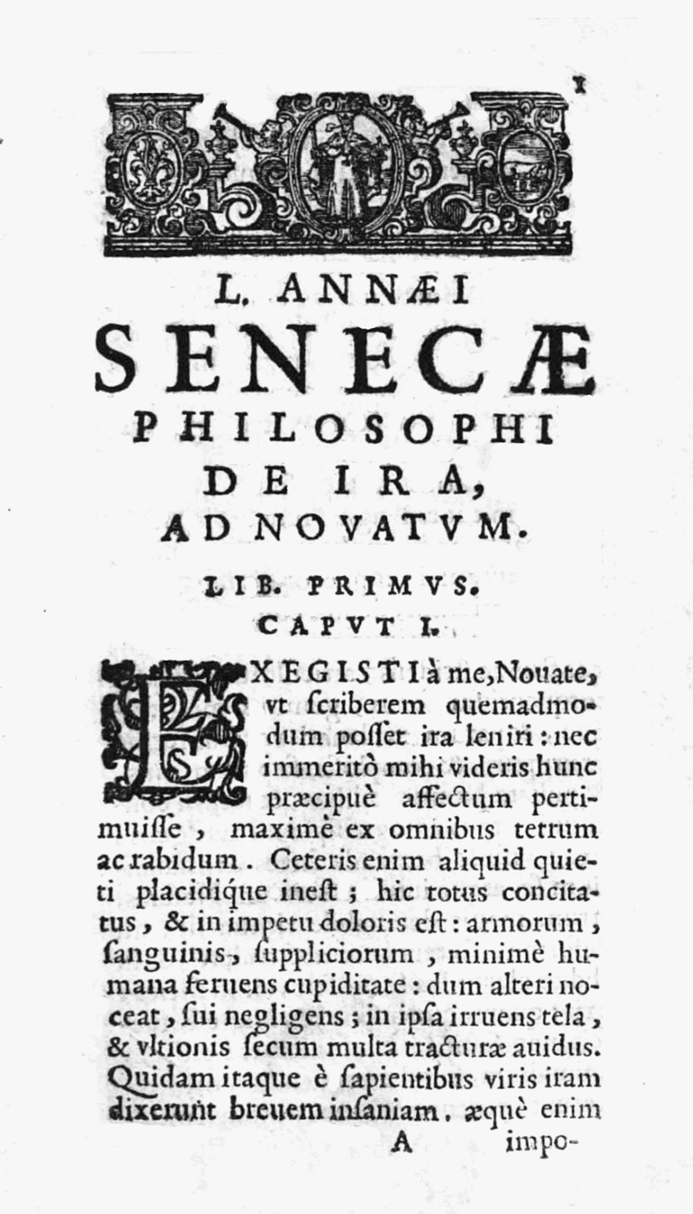
Seneca On Anger
Latin work by Seneca
Explores anger in the Stoic context
  Offers therapy for anger: prevent and control
Should not merely control, but utterly destroy the passions and their hold on people
We shouldn't control anger, but destroy it entirely—for what "control" is there for a thing that's fundamentally wicked?
–Seneca, De Ira, iii.42

Slide 12
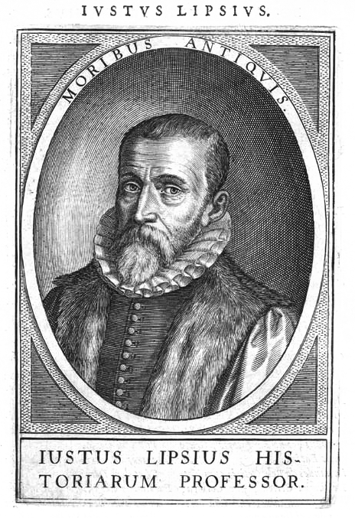
Neo-Stoicism
Stoicism and Christianity
Justus Lipsius (1547 — 1606) Flemish philologist and humanist
Attempted to combine the beliefs of Stoicism and Christianity
Explores contemporary political events through stoic lens
Neostoicism: practical philosophy → the basic rule of good life is that the human should not yield to the passions → but submit to God.
Four passions: greed, sorrow, fear, joy
Humans have free will, but everything is under the control of God → all tends towards God
Similar to classical Stoics, belief that humans not bound by passions is free

Slide 13

Modern Stoicism and Psychotherapy
Stoic philosophy was the original philosophical inspiration for modern cognitive psychotherapy
  Dr Albert Ellis' Rational-Emotive Behaviour Therapy (REBT), the major precursor of CBT.
Quotation from The Handbook of Epictetus taught to most clients during the initial session of traditional REBT by Ellis and his followers: "It's not the events that upset us, but our judgments about the events.“
  Became the element of “socialization” in CBT.

Slide 14
Next week
Tuesday Nov 20, 2018
8:45-9:50 Art and Architecture of the Roman Republic, Gamble
10:00-10:50 The Expansion of the Republic, Tom
Thursday Nov 22, 2018
No Class

